Slide 2

Predictions - Adding Machine Learning to Your Apps with Zero Back End Code
Name
Title
Twitter - @handle

Slide 3
Agenda
What is AI/ML?
What is AWS Amplify?
How is this different?
Amplify Predictions
Build an AI/ML web app
Resources
Q&A

Slide 4
What is AI/ML?

Slide 5
AI/ML
Artificial Intelligence
Decision making.
Goal: Simulate natural intelligence and solve complex problem.
Machine learning
Enables systems to learn new things from data.
Goal: Learn from data to maximize the performance of machine on a task

Slide 6
AWS AI Managed AI Services
Amazon CodeGuru
Amazon Comprehend
Amazon Forecast
Amazon Fraud Detector
Amazon Lex
Amazon Polly
Amazon Rekognition
Amazon Textract
Amazon Transcribe
Amazon Translate
Amazon Personalize

Slide 7
AWS ML Managed ML Services
Amazon Sagemaker
Amazon Sagemaker Ground Truth
Amazon Sagemaker Neo
Amazon Augmented AI

Slide 8
What is AWS Amplify?

Slide 9
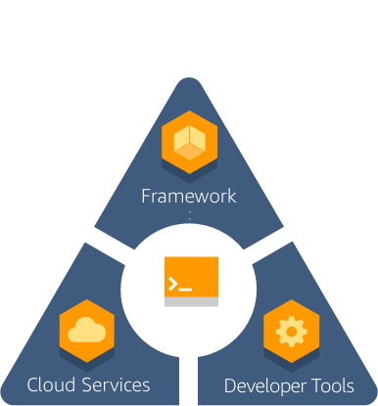
AWS Amplify
Components
CLI
Client Libraries (iOS, Android, JS)
UI Components
Console – CI/CD and Hosting
Device Farm
Amplify Framework
Developer Tools

Slide 10


How is this different?
Amplify Clients
Use-case centric
Declarative abstractions
(E.g. Storage.put())
AWS Mobile SDKs
AWS Service centric
Low level generated
(E.g. AWSS3TransferUtilityUploadExpression)
Both can be used in the same app.

Slide 11
Amplify Framework
Open source
Opiniated
Categories based high level abstractions
Declarative
Best practices built-in
Escape hatches

Slide 12

Amplify Framework - Capabilities
DataStore
On-device persistent storage that automatically synchronizes data between you apps and the cloud.
Predictions
Add MI/ML capabilities to your app powered by cloud services
Analytics
Track user sessions, custom user attributes and in-app metrics
API
HTTP requests using REST and GraphQL with support for real-time data
Auth
AuthN + AuthZ library with prebuilt UI components for your app
Interactions
Conversational bots powered by deep learning technologies
PubSub
Connect your app to message-oriented middleware on the cloud
Notifications
Push notifications with campaign analytics and targeting
Storage
Manage user content securely in public, protected, and private storage.
XR
Work with augmented reality and virtual reality content in your apps

Slide 13
Amplify CLI

Slide 14

Amplify Framework
CLI
Create and manage your backend
Categories
Multiple environments
GraphQL Transform
Plugins
Notes:
GraphQL transform you can define your application data mode using GraphQL SDL ad the library handles converting your SDL definition in to full descriptive AWS CloudFormtaion +
Codegen helps you generate native code for iOS and Android, as well as types for Flow and TypeScript. It can also generate GraphQL statements(queries, mutations, and subscriptions) so that you don’t have to hand code them.

Slide 15
Amplify CLI
Categories
Auth (AuthN+AuthZ) Predictions (AI/ML)
Analytics Serverless Functions
API (GraphQL/REST) Storage
Interactions (chat bots) XR (AR/VR)

Slide 16
Amplify CLI
$ amplify add auth
$ amplify push
$ amplify configure auth
$ amplify remove auth
$ amplify delete

Slide 17
Amplify CLI
Multiple environments
$ amplify env add
$ amplify env list
$ amplify env checkout
$ amplify env remove

Slide 18
Amplify Client Libraries

Slide 19










Amplify Framework
Client libraries
Connect and interact with cloud services from your app
Platforms: iOS, Android, Web
JS Frameworks: React Native, React, Angular, Vue, and Ionic
Category based

Slide 20
Amplify Client Libraries
Categories
Auth (AuthN+AuthZ) Predictions (AI/ML)
Analytics PubSub
API (GraphQL) Push Notifications
API (REST) Storage
Interactions (chat bots) XR (AR/VR)

Slide 21
Amplify Framework Client
$ npm install aws-amplify
import {
Auth, API, Storage, Analytics, XR
} from ‘aws-amplify’

Slide 22
Amplify Framework Client
import {
API
} from ‘aws-amplify’
API.get(’apiname’, ‘path’)

Slide 23
Amplify Predictions

Slide 24
Amplify Framework
Predictions category
Easily add AI/ML use cases powered by Amazon AI/ML services
No machine learning experience required
Few lines of code
Support for custom models through SageMaker
Apple CoreML Vision Framework support for iOS
@predictions to orchestrate multiple AI/ML actions using GraphQL
Notes:
You can invoke the SageMaker models via a REST API.
No ML required.

Slide 25
Amplify Framework
Predictions category use cases
Translating text
Text to speech
Text recognition
Entities recognition
Label real world objects
Interpretation of text
Uploading images for automatic training
Transcribing text
Notes:
You can invoke the SageMaker models via a REST API.
No ML required.

Slide 26
Amplify Framework
Predictions category services
Amazon Translate
Natural and accurate language translation
Highly Accurate & Continuously Learning
Easy to integrate
Customizable
Scalable
Notes:
You can invoke the SageMaker models via a REST API.
No ML required.

Slide 27
Amplify Framework
Predictions category services
Amazon Polly
Turn text into lifelike speech using deep learning
Natural sounding voices
Store & redistribute speech
Real-time streaming
Customize & control speech output
Notes:
Amazon Polly allows for unlimited replays of generated speech without any additional fees. You can create speech files in standard formats like MP3 and OGG, and serve them from the cloud or locally with apps or devices for offline playback.
Polly returns the audio to your application as a stream so you can play the voices immediately.
Supports lexicons and SSML tags which enable you to control aspects of speech, such as pronunciation, volume, pitch, speed rate, etc.

Slide 28
Amplify Framework
Predictions category services
Amazon Transcribe
Automatically convert speech to text
Easy-to-Read Transcriptions
Streaming transcriptions
Timestamp Generation
Recognize Multiple Speakers
Custom Vocabulary
Notes:
Adds punctuation and formatting so that the output closely matches the quality of manual transcription
Streaming Transcription – send as a stream, return response as a stream
Returns a timestamp for each word, so that you can easily find a word or phrase in the original recording or add subtitles to video.
You can add new words to the base vocabulary to generate more accurate transcriptions for domain-specific words and phrases like product names, technical terminology, or names of individuals.

Slide 29
Amplify Framework
Predictions category services
Amazon Rekognition
Automates image and video analysis with machine learning
Label real world objects
Content moderation
Text detection
Face search and verification
Face detection and analysis
Celebrity recognition
Notes:
Helps you identify potentially unsafe or inappropriate content across both image and video assets and provides you with detailed labels that allow you to accurately control what you want to allow based on your needs.
Can read skewed and distorted text to capture information like store names, street signs, and text on product packaging.

Slide 30
Amplify Framework
Predictions category services
Amazon Textract
Easily extract text and data from virtually any document
Extract data quickly & accurately
Form Extraction, Table Extraction
Bounding Boxes
No code or templates to maintain
Adjustable Confidence Thresholds
Notes:
Helps you identify potentially unsafe or inappropriate content across both image and video assets and provides you with detailed labels that allow you to accurately control what you want to allow based on your needs.
Can read skewed and distorted text to capture information like store names, street signs, and text on product packaging.

Slide 31
Amplify Framework
Predictions category services
Amazon Comprehend
Discover insights and relationships in text
Keyphrase Extraction
Sentiment Analysis
Syntax Analysis
Entity Recognition
Comprehend Medical
Custom Entities
Notes:
Helps you identify potentially unsafe or inappropriate content across both image and video assets and provides you with detailed labels that allow you to accurately control what you want to allow based on your needs.
Can read skewed and distorted text to capture information like store names, street signs, and text on product packaging.

Slide 32
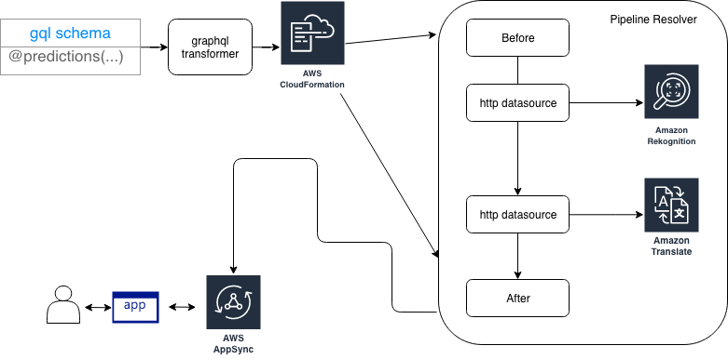
Amplify Framework
@predictions directive
Notes:
You can invoke the SageMaker models via a REST API.
No ML required.

Slide 33







Amplify iOS: Predictions
Pre-trained models
CoreML models
Custom models
Amazon Rekognition
Amazon Comprehend
Amazon Polly
Amazon Textract
Amazon SageMaker
Amazon Transcribe
Amazon Translate
Notes:
You can invoke the SageMaker models via a REST API.
No ML required.

Slide 34
Notes:
You can invoke the SageMaker models via a REST API.
No ML required.

Slide 35
Notes:
You can invoke the SageMaker models via a REST API.
No ML required.

Slide 36
Notes:
You can invoke the SageMaker models via a REST API.
No ML required.

Slide 37
Let’s build an AI/ML web app

Slide 38
Resources
Instructions for today’s session:
https://aws.amazon.com/blogs/mobile/announcing-the-new-predictions-category-in-amplify-framework/
https://aws.amazon.com/blogs/mobile/amplify-cli-announces-new-graphql-transform-feature-for-orchestrating-multiple-ai-ml-use-cases/
AWS Amplify Docs
https://aws-amplify.github.io/
Predictions category Documentation
https://aws-amplify.github.io/docs/js/predictions
Amplify community
https://amplify.aws/community/
AWS Amplify GitHub Repos
https://github.com/aws-amplify

Slide 39
Questions

Slide 40
Thank you !

